Slide 1
Welcome to
Shelter Fundamentals
Revised April, 2017
Sheltering@Redcross.org

Slide 2
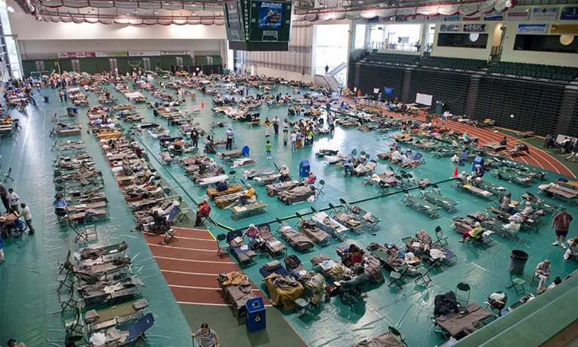

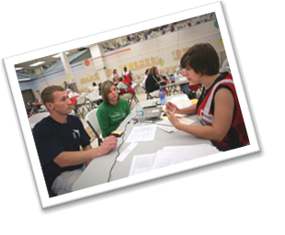
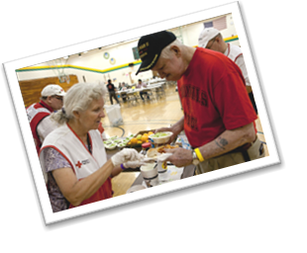
Sheltering Process—Course Purpose
Planning and Preparedness
Planning the Sheltering Operation
Resourcing the Shelter
Opening the Shelter
Operating the Shelter
Closing the Shelter
Sheltering
Process
Course Purpose: To prepare you to assist in the resourcing, opening, operating and closing of a Red Cross shelter.

Slide 3
Introductions
Activity
What is your name?
What one item would you want to bring from home if you were sheltering with the Red Cross?
What do you hope to learn today?

Slide 4
Course Objectives
Upon completion of this course, you will be able to:
Describe the tasks of a shelter worker throughout the resourcing, opening, operating and closing phases of a shelter operation.
Recall the tasks on the shelter checklists.
Explain how to set up welcoming reception and registration areas.
Describe how to receive clients, complete the appropriate registration forms and make referrals for additional services, as needed.
Identify internal and external locations for posting signs that clearly communicate shelter information.
Explain how to set up and monitor a dormitory environment that ensures client safety and comfort.
Explain how to set up food distribution areas and monitor consumption to ensure that clients’ dietary needs are met.
Describe the importance of information sharing in a shelter environment and identify multiple communication strategies.
Explain the steps required to return a shelter to its pre-disaster condition.

Slide 5

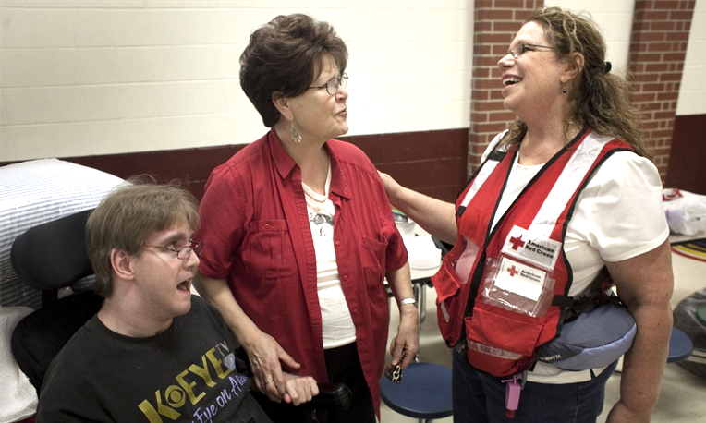
Mission and Commitment
  Our Commitment
  Our commitment as shelter workers is to take care of the sheltering needs of people affected by disaster. We are committed to providing shelter on an interim basis while our clients arrange for their recovery or until they are able to return home. We demonstrate this commitment in our Sheltering Program Principles.
Mission Statement
The American Red Cross prevents and alleviates human suffering in the face of emergencies by mobilizing the power of volunteers and the generosity of donors.

Slide 6
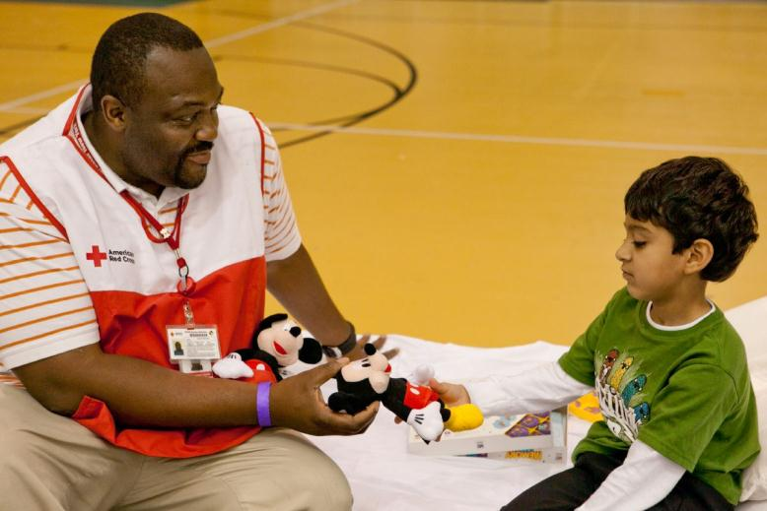
Sheltering Program Principles
  A successful sheltering program…
  Is designed first on the needs and expectations of clients.
  Has the ability to provide and communicate the location of a safe environment for the impacted community.
  Is provided consistently across the country and is continuously improved.

Slide 7

Case Study
Notes:
Case Study Introduction

Slide 8
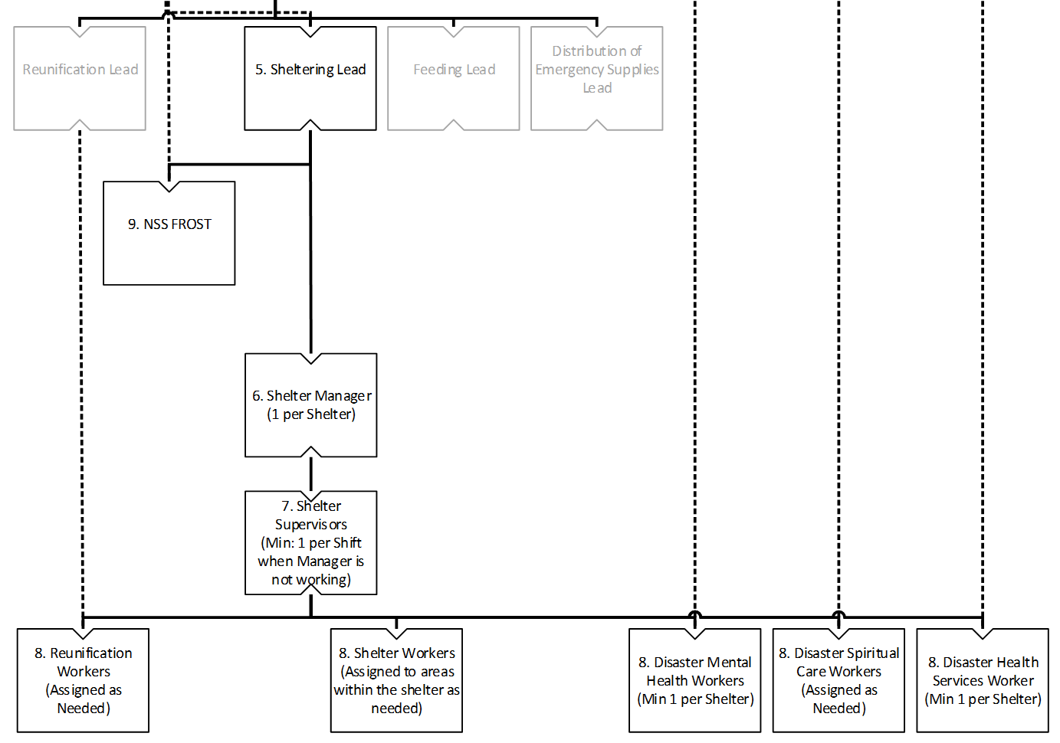
Organization Chart

Slide 9
Sheltering Process
Planning and
Preparedness
Planning the Sheltering Operation
Resourcing the Shelter
Opening the Shelter
Operating
the Shelter
Closing the Shelter

Slide 10
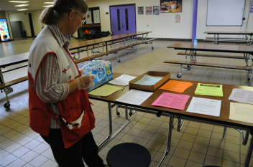
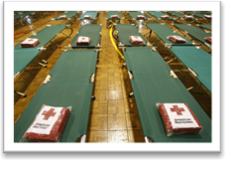
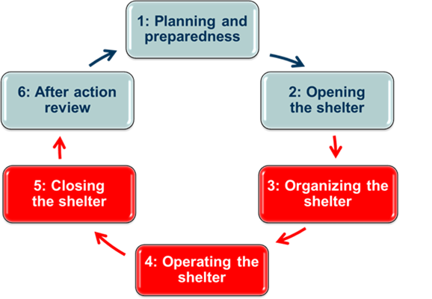
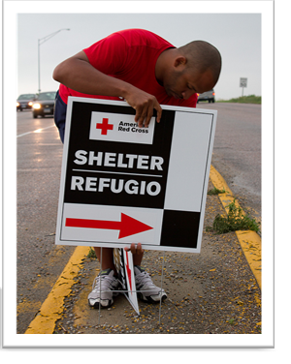
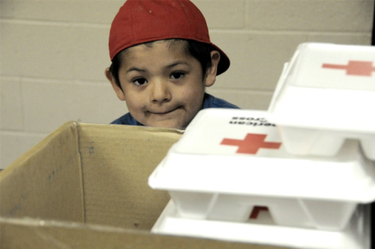
Resourcing a Shelter
Set up Information Area
Set up Dormitory
Set up Feeding
Put up Signs

Slide 11
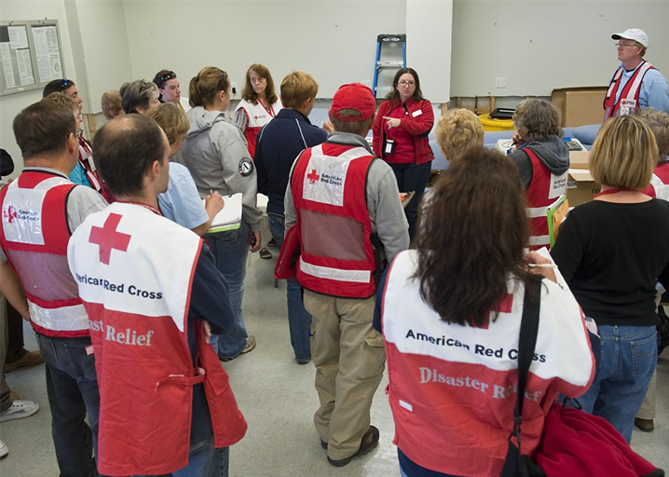
Job Induction
    During a Job Induction you can expect to:
    Discuss your skills and strengths
    Set expectations
    Exchange contact information
    Learn about the work site
    Establish a work schedule
    Review your work assignment
    Important: A job induction is provided for all staff; ask for a job induction if one is not provided!

Slide 12
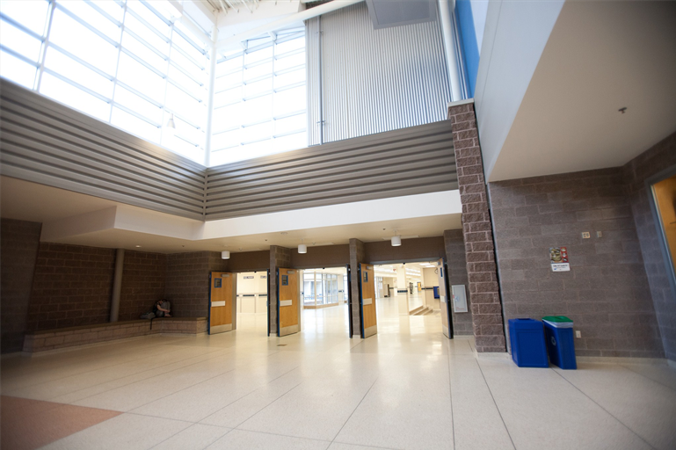
Organizational Tips
  For every job, always:
  Look for pre-existing damage
  Ask about available equipment
  Take inventory of all facility products
  Consider accessibility
12

Slide 13
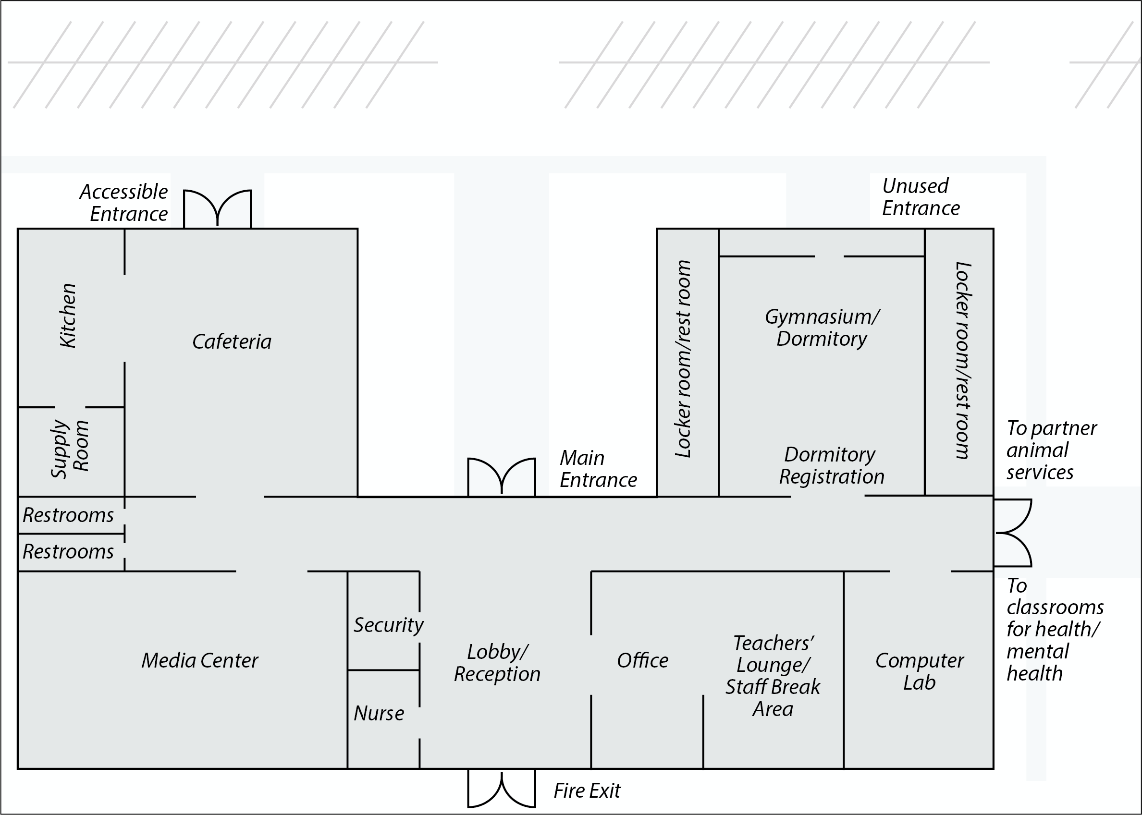
School Floor Plan
13

Slide 14
Setting Up Reception and Registration
Activity
Working in your group,
Draw a layout of the Reception and Registration Areas in the blow-up of the main lobby on the floor plan
Use the Resourcing the Shelter Checklist—Reception and the Resourcing the Shelter Checklist–Registration to help you make decisions
Be prepared to share the reasons for your decisions
Timeframe: 5 minutes

Slide 15


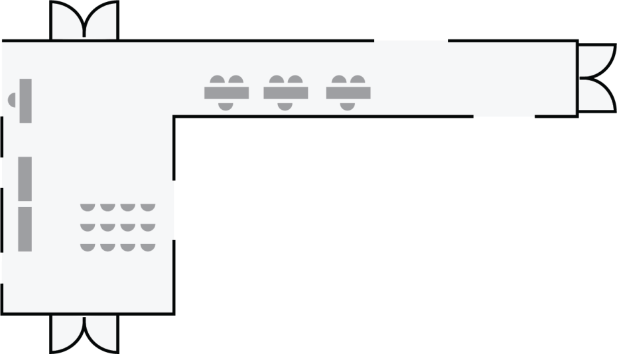
Reception and Registration Areas Plan
15

Slide 16
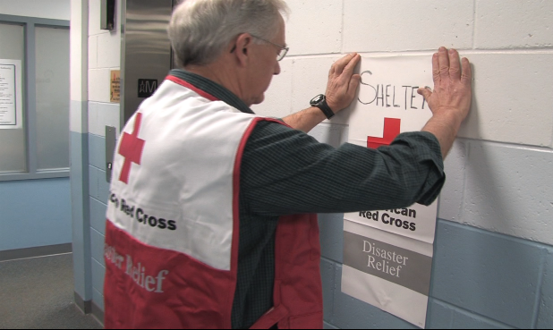
Information Area

Slide 17
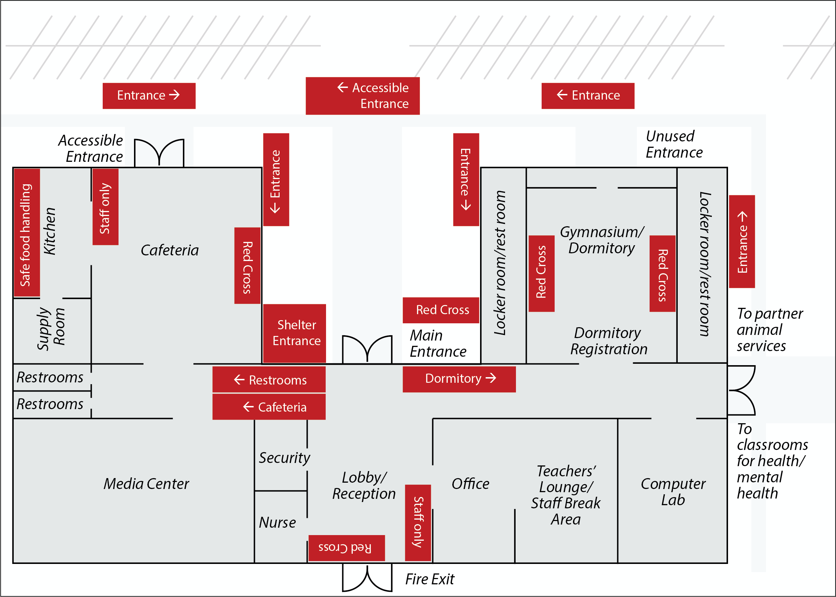
Posting Signs

Slide 18
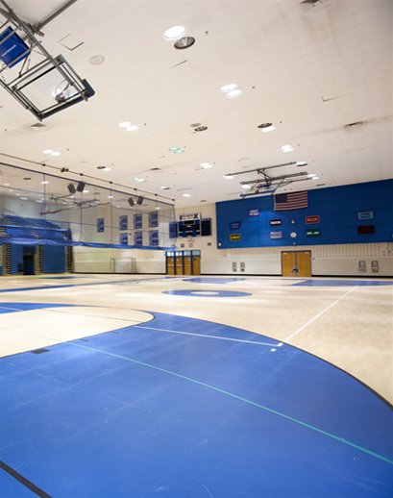
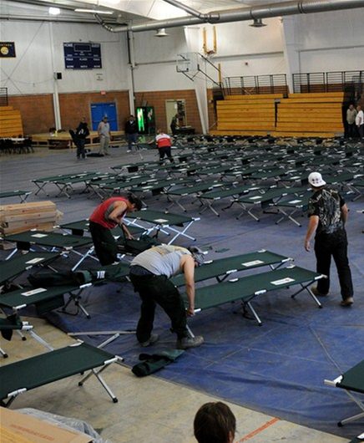
Shelter Types
Evacuation Shelter
General Population Shelter

Slide 19

Dormitory Floor Plan

Slide 20
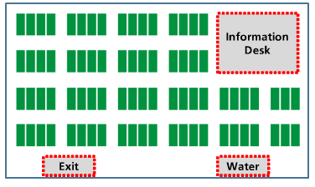
Dormitory Floor Plan 2

Slide 21
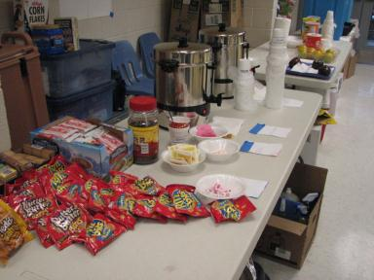
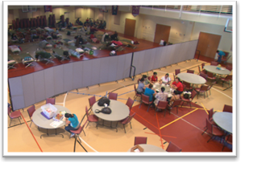
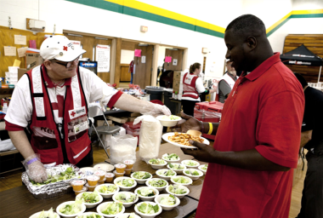
Setting Up Feeding Areas
Snack and Beverage Table
Dining Area
Serving Area

Slide 22
Shelter Inventory Form
22

Slide 23
Sheltering Process
Planning and
Preparedness
Planning the Sheltering Operation
Resourcing the Shelter
Opening the Shelter
Operating
the Shelter
Closing the Shelter
Registration
Information Area
Dormitory
Feeding

Slide 24
Operating Forms
24

Slide 25
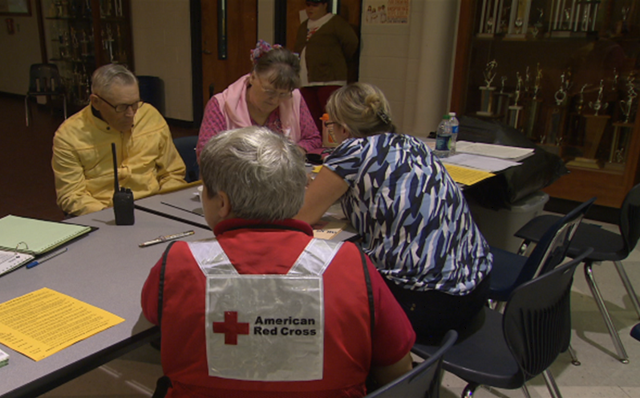
Reception Area
When you work in the shelter’s reception area, you may be the first contact clients have with the Red Cross.
To welcome them in, you will:
Have clients sign in when they enter the shelter, even if they are not staying in the dormitory.
Identify the clients’ initial needs and direct them to resources.
Allow individuals with access or functional needs, including those with disabilities, to bring their service animals into the shelter, including the dormitory.

Slide 26
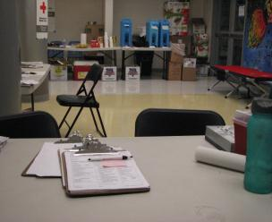
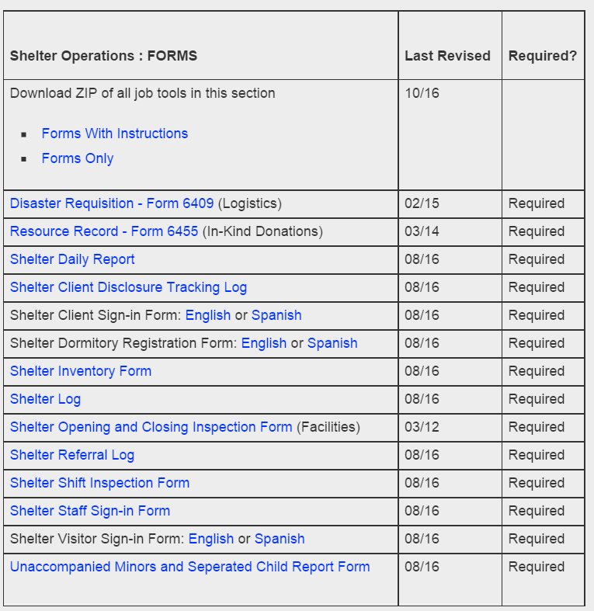
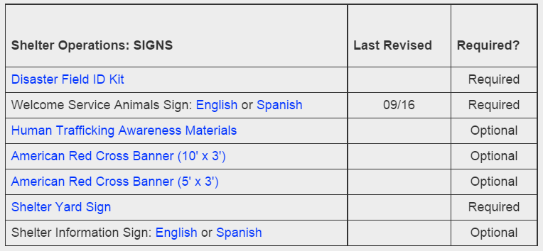
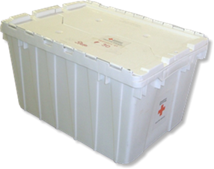
Shelter Forms

Slide 27
Registration Forms
Activity
Review the following:
  Shelter Dormitory Registration form
  Shelter Referral Log
  Opening and Operating the Shelter Checklist—Reception and Registration
With your partner, identify each form’s purpose.
Describe what is contained on each form.
List any additional comments or notes of interest.
Timeframe: 5 minutes

Slide 28
Shelter Client Welcome Handout
28

Slide 29
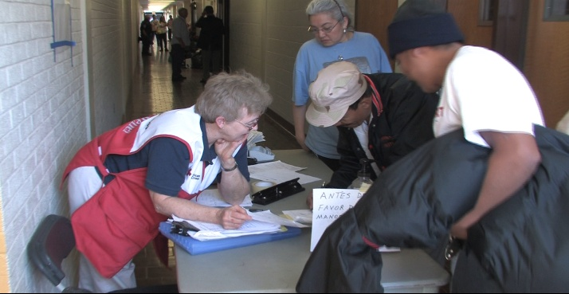
Reception and Registration Challenges
  Long lines
  Running out of forms
  Clients who are injured, hungry or needing medication

Slide 30
Reception and Registration Tips
  Tips for working in reception and registration:
  Provide snacks and drinks in the reception area.
  Ensure the reception and registration tables are always staffed.
  Distribute the Shelter Client Welcome handout while clients are in line to register.
  Keep client paperwork secure and confidential.
  Make a referral to a health worker if someone needs medical attention. Call 911 if the client has urgent medical needs.

Slide 31





Visitors

Slide 32
What if a visitor made this request?
“What if…?”
“I’m working on a project with Joey M. I want to take him to the library. He’s here, right?”
“I have a package for Jenn P. Can you give this to her?”
“I’m worried about my dad; he suffers from Alzheimer’s. We haven’t heard from him since he left his house yesterday. He might be here. Can you help me find him?”
How should you respond?
32

Slide 33
What if this situation happened?
More Visitors
A Springfield police officer wants to see the shelter records and walk around to see if a suspect in a murder investigation is in the shelter.
A state senator arrives and walks toward the dormitory.
A reporter with her crew signs in and starts to walk toward the dormitory.
What would you do?
33

Slide 34
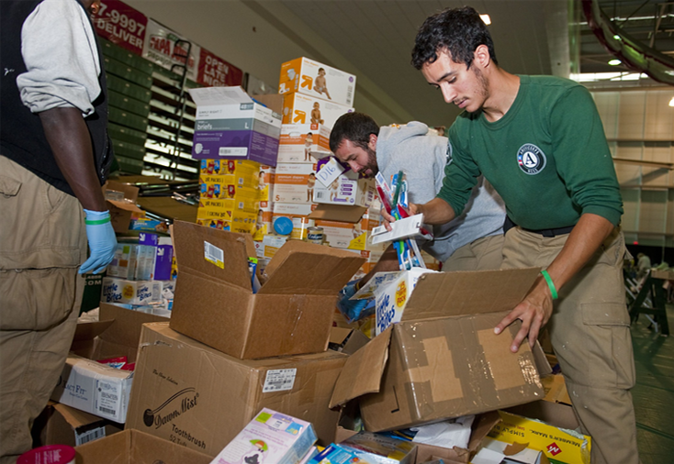
Partners and Providers

Slide 35

Offers of Assistance
Money should not be accepted at the shelter because it may create the impression that Red Cross is accepting fees for services.
If people would like to donate:
  Provide a donation envelope from the Shelter Supply Kit.
  Provide the website, toll-free number and text message instructions.

Slide 36
Visitor Review
When dealing with visitors:
Be courteous and kind, but firm.
Ensure that people sign in and out of the shelter as required.
Have visitors meet with the shelter manager when necessary.
Never release confidential information or identities of clients.
Know the procedure for handling all types of donations.

Slide 37
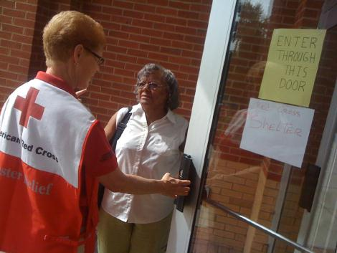
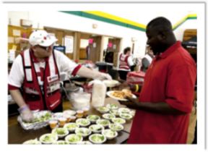

Shelter Roles
Information Area
Feeding
Dormitory

Slide 38
Shelter Teams
Activity
In your group, answer the following questions for your assigned area:
    What rules or routines do I need to know?
    What are the tasks involved?
    What will make me successful?
Refer to the appropriate checklist for your group:
  Information Area
  Dormitory
  Feeding
Record your information on newsprint.
Timeframe: 7 minutes

Slide 39
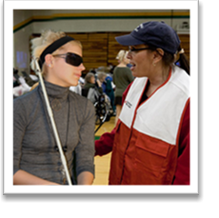

Information Area

Slide 40
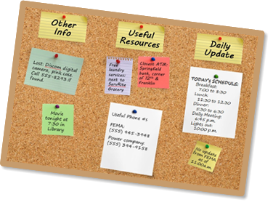
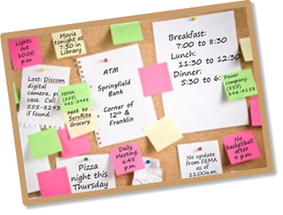
Effective Communication

Slide 41
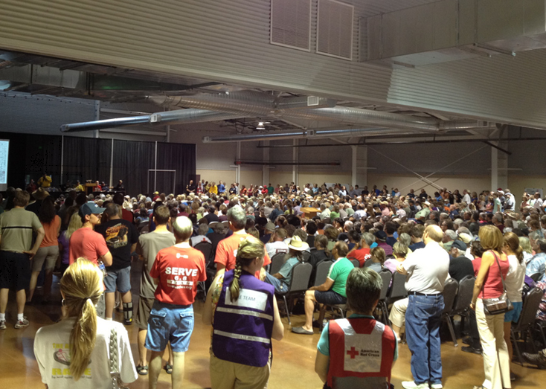
Shelter Meetings

Slide 42
Types of Information
General shelter information, such as meal times, lights out, etc.
Status of the disaster
Information about the disaster relief operation
Community resources, including government, non-profit and faith-based
Daily schedule
Safety concerns and issues
Recreational activities
Opportunities for clients to act as shelter client helpers

Slide 43
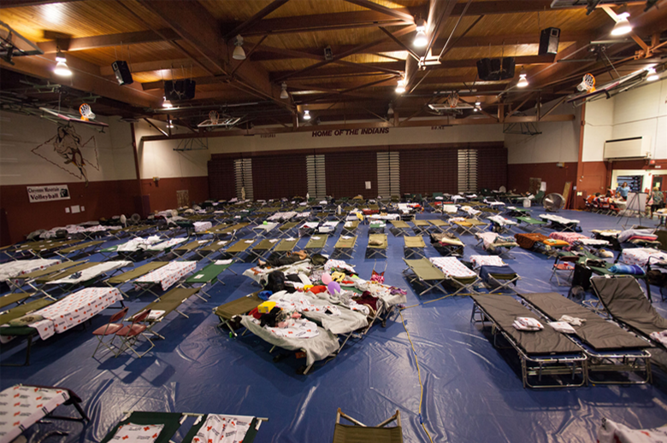
Operating the Dormitory

Slide 44
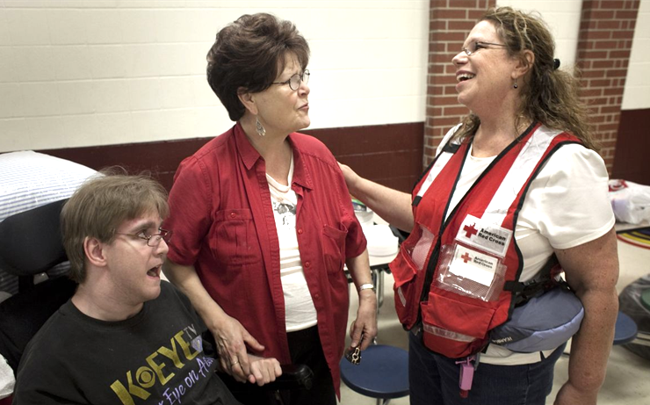
Talking to Clients
Offer encouragement.
Uncover concerns or unmet needs.
Make referrals to caseworkers.

Slide 45
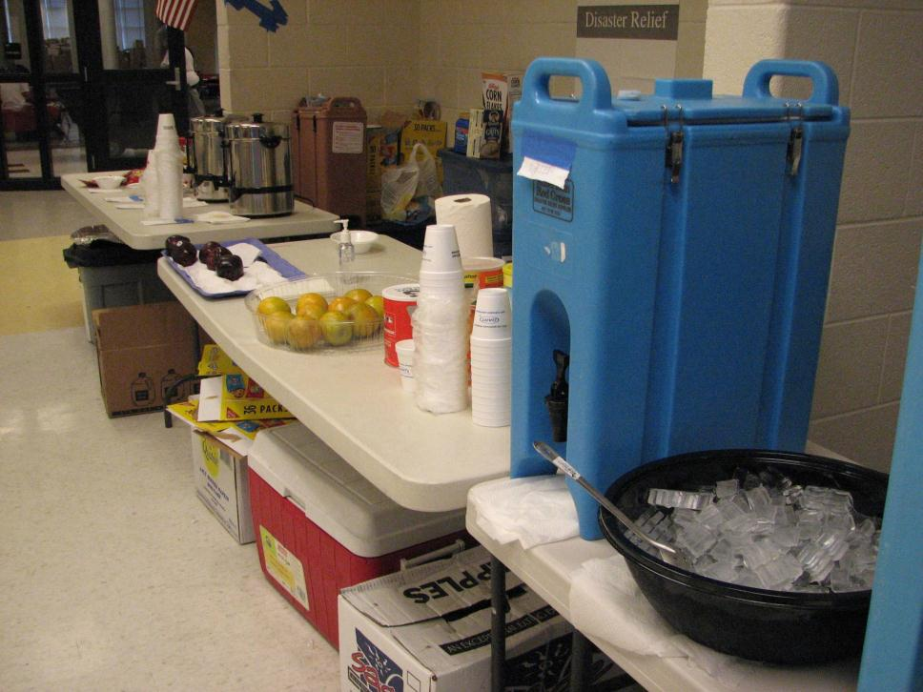
Feeding and Inventory

Slide 46
Taking Inventory
General Inventory Guidelines:
It is important to have an initial inventory of everything in the shelter, including non-food items.
Food items are counted when they are put out.
Each individual snack table item counts as a snack; water or coffee counts as one snack, unless served with a meal.
Everyone should look for inventory issues.

Slide 47
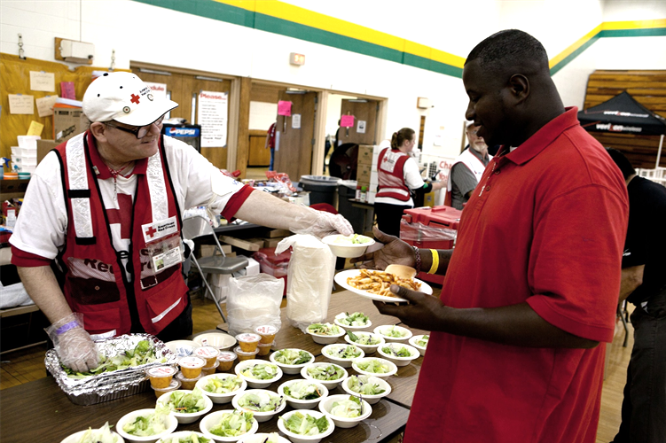

Safe Handling of Food

Slide 48
Sheltering Process
Planning and
Preparedness
Planning the Sheltering Operation
Resourcing the Shelter
Opening the Shelter
Operating the Shelter
Closing the Shelter

Slide 49
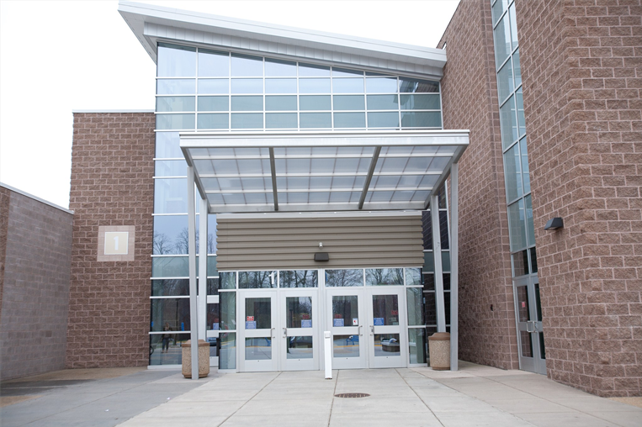
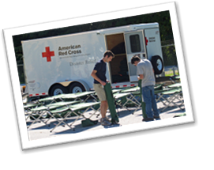
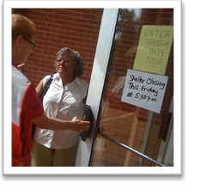
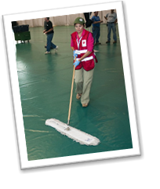
The Closing Process
Communicating the shelter closing to residents
Taking inventory
Finalizing and securing records
Cleaning equipment
Restocking and returning supplies
Returning the shelter to its pre-disaster condition

Slide 50
Closing Checklist
Closing Tasks
General
Cleaning
Reporting and Inventory
Reception and Registration
Reporting
Supplies
Supplies and Equipment
Feeding
Information Area
Dormitory
Supplies
Clients
Cots
Clients
50

Slide 51
Taking Closing Inventory

Slide 52
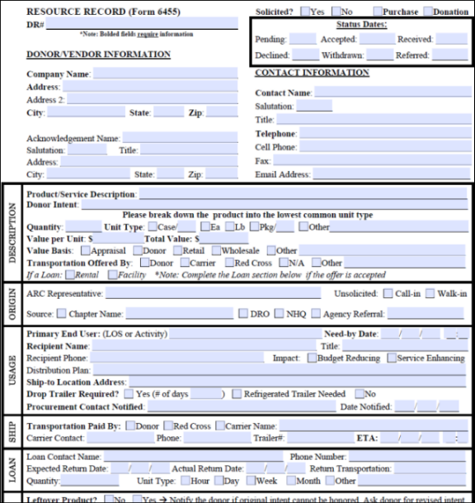
Resource Record (Form 6455)
52

Slide 53
Shelter Log

Slide 54
Sheltering Program Principles
  A successful sheltering program…
  Is designed first on the needs and expectations of clients.
  Has the ability to provide and communicate the location of a safe environment for the impacted community.
  Is provided consistently across the country and is continuously improved.

Slide 55
Sheltering Program Principles
Activity
  Sheltering Program Principles
  A successful sheltering program…
  Is designed first on the needs and expectations of clients.
  Has the ability to provide and communicate the location of a safe environment for the impacted community.
  Is provided consistently across the country and is continuously improved.
Identify three ways you can help fulfill the Sheltering Program Principles in your assigned role.
Timeframe: 5 minutes

Slide 56
Course Closing
Planning and
Preparedness
Planning the Sheltering Operation
Resourcing the Shelter
Opening the Shelter
Operating the Shelter
Closing the Shelter

Slide 57


Case Study Introduction
57
Notes:
Case Study Introduction

Slide 58
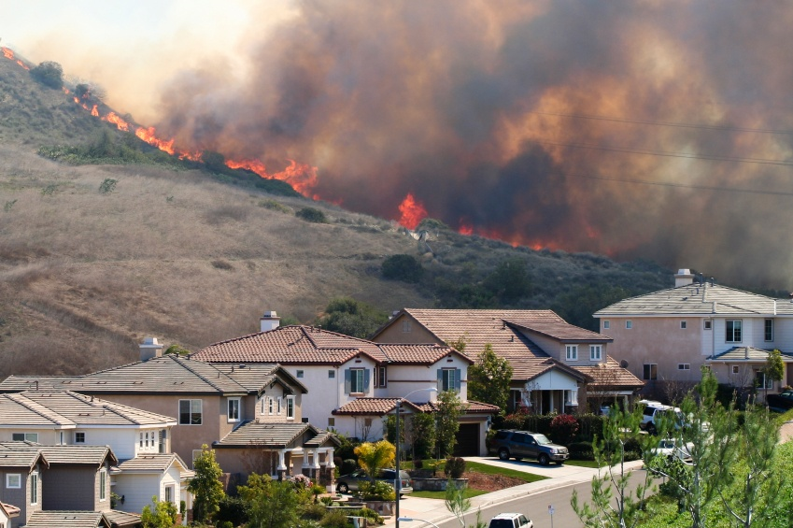

Case Study Introduction
58
Notes:
Case Study Introduction

